Slide 1
Pentium Processors

Slide 2
Pentium Architecture
The Pentium family of processors originated from the
80486 microprocessor.
-The term ''Pentium processor'' refers to a family of
microprocessors that share a common architecture and
instruction set.
-The first Pentium processors were introduced in 1993.
- It runs at a clock frequency of either 60 or 66 MHz
- It has 3.1 million transistors.

Slide 3
Pentium processor executes instructions in five stages. This staging, or pipelining, allows the processor to overlap multiple instructions so that it takes less time to execute two instructions in a row.
The Pentium processor fetches the branch target instruction before it executes the branch instruction.
The Pentium processor has two separate 8-kilobyte (KB) caches on chip, one for instructions and one for data. It allows the Pentium processor to fetch data and instructions from the cache simultaneously.

Slide 4
Features of Pentium
Complex Instruction Set Computer (CISC) architecture with Reduced Instruction Set Computer (RISC) performance.
64-Bit Bus
Upward code compatibility.
Pentium processor uses Superscalar architecture and hence can issue multiple instructions per cycle.
Multiple Instruction Issue (MII) capability.

Slide 5
When data is modified, only the data in the cache is changed. Memory data is changed only when the Pentium processor replaces the modified data in the cache with a different set of data
The Pentium processor has been optimized to run critical instructions in fewer clock cycles than the 80486 processor.

Slide 6
Superscalar Architecture of Pentium

Slide 7
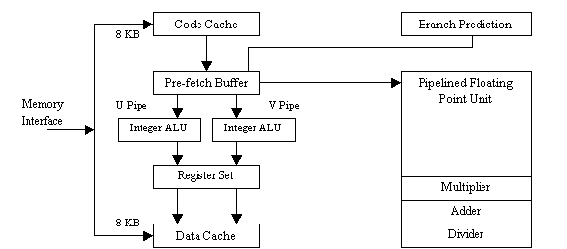
Superscalar Architecture of Pentium

Slide 8
The Pentium processor has two primary operating modes:
Protected Mode - In this mode all instructions and architectural features are available, providing the highest performance and capability. This is the recommended mode that all new applications and operating systems should target.
Real-Address Mode - This mode provides the programming environment of the Intel 8086 processor, with a few extensions. Reset initialization places the processor in real mode where, with a single instruction, it can switch to protected mode

Slide 9
Pipelining in Pentium
The Pentium's basic integer pipeline is five stages long, with the stages broken down as follows:
Pre-fetch/Fetch : Instructions are fetched from the instruction cache and aligned in pre-fetch buffers for decoding.
Decode1 : Instructions are decoded into the Pentium's internal instruction format. Branch prediction also takes place at this stage.
Decode2 : Same as above, and microcode ROM kicks in here, if necessary. Also, address computations take place at this stage.
Execute : The integer hardware executes the instruction.
Write-back : The results of the computation are written back to the register file.

Slide 10
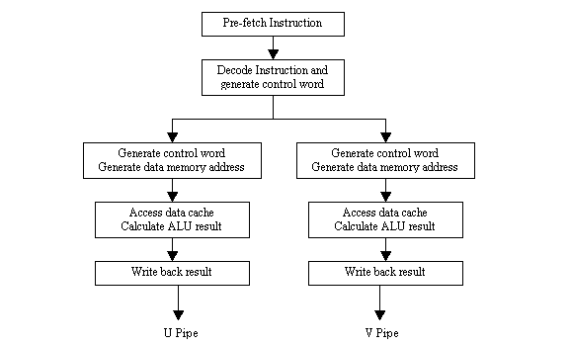
Fig. Pentium pipeline stages

Slide 11
- There are 8 general-purpose 80-bit Floating point registers. - --- Floating point unit has 8 stages of pipelining.
- First five are similar to integer unit.
Since the possibility of error is more in Floating Point unit
(FPU) than in integer unit,
- Additional error checking stage is there in FPU.

Slide 12
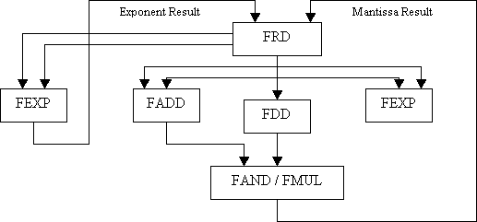
Floating Point Unit

Slide 13
FRD - Floating Point Rounding FDD - Floating Point Division FADD - Floating Point Addition FEXP - Floating Point Exponent FAND - Floating Point And FMUL - Floating Point Multiply

